Slide 1
Learning 3D Representations of Molecular Chirality With Invariance to Bond Rotations

Slide 2
Contents
Stereochemistry and Chirality
The Design of Chiral InterRoto-Invariant Neural Network (ChiRo)
Experiments
Discussion

Slide 3
Stereochemistry & Chirality

Slide 4
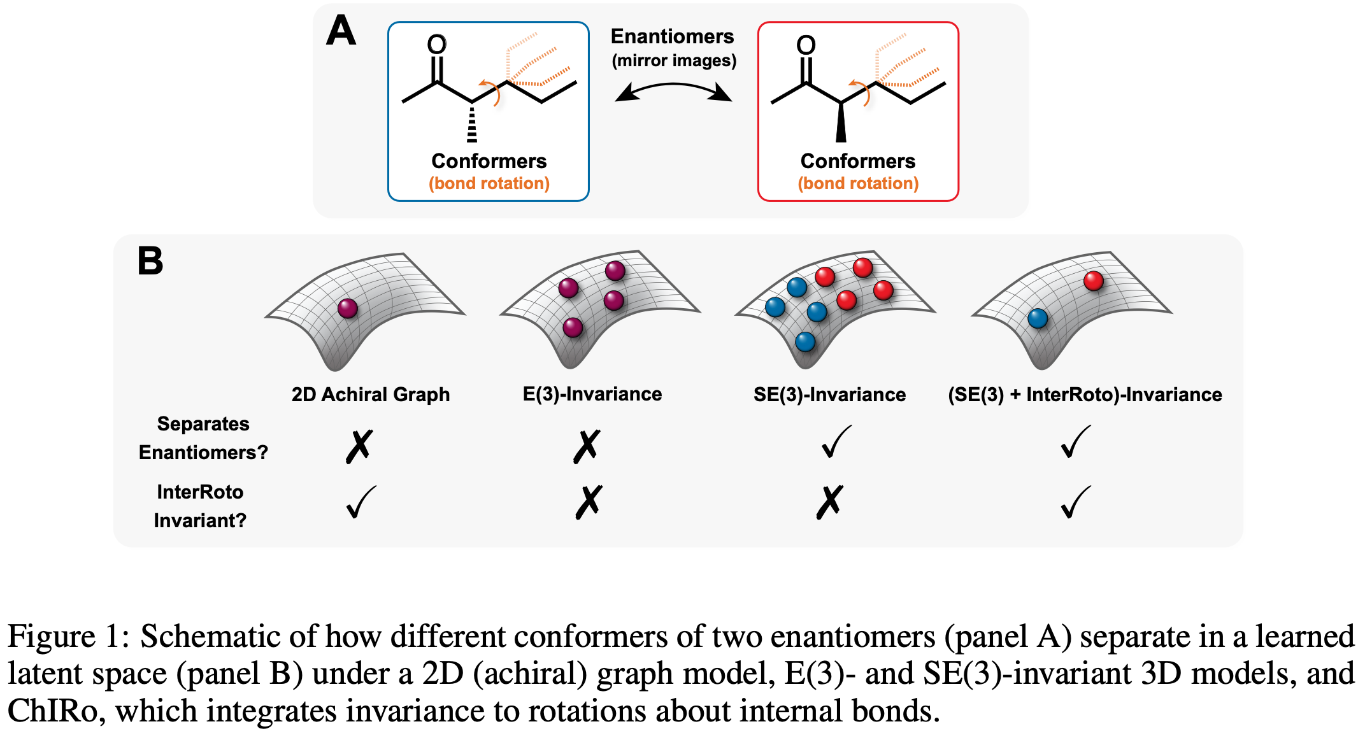
Stereochemistry & Chirality

Slide 5
Chiral InterRoto-Invariant Neural Network (ChiRo)
2D Graph Encoder
Bond Distance and Bond Angle Encoders
Torsion Encoder
Readout

Slide 6
Chiral InterRoto-Invariant Neural Network (ChiRo)
2D Graph Encoder
Initialize a 2D graph G.
Nodes: atoms initialized with features $x_{i}$
Edges: Bonds initialized with features $e_{ij}$
$x_{i}$: Atomic mass, one-hot encodings of atom type, formal charge, degree, Number of hydrogens, Hybridization state
$e_{ij}$: One-hot encoding of the bond type, whether the bond is conjugated, whether the bond is in a ring system.

Slide 7
Chiral InterRoto-Invariant Neural Network (ChiRo)
2D Graph Encoder
The author uses edge convolution (EConv) to embed the node features with the edge features.
$$h_{i}^{0}=Θx_{i}+\underset{j∈N(i)}{∑}x_{j}⋅f_{e}\left(e_{ij}\right)$$
Node states $h_{i}^{t}∈R^{h_{t}}$ are updated through T sequential Graph Attention Layers (GAT)
$$h_{i}^{t}={GAT}^{(t)}\left(h_{i}^{t-1},{\left\{h_{j}^{t-1}\right\}}_{j∈N(i)}\right),t=1,…,T$$

Slide 8
Chiral InterRoto-Invariant Neural Network (ChiRo)
Bond Distance and Bond Angle Encoders
The author individually encodes each bond distance $d_{ij}$ (Angstroms) and angle $ϕ_{ijk}$ into learned latent vectors. Then sum-pool the vectors to get conformer-level latent embeddings $z_{d}$ and $z_{ϕ}$
$$z_{d}=\underset{(i,j)∈G}{∑}f_{d}\left(h_{i},h_{j},d_{ij}\right)+f_{d}\left(h_{j},h_{i},d_{ij}\right)$$
$$z_{ϕ}=\underset{(i,j,k)∈G}{∑}f_{ϕ}\left(h_{i},h_{j},h_{k},cosϕ_{ijk},sinϕ_{ijk}\right)+f_{ϕ}\left(h_{k},h_{j},h_{i},cosϕ_{ijk},sinϕ_{ijk}\right)$$

Slide 9
Chiral InterRoto-Invariant Neural Network (ChiRo)
Torsion Encoder
Two properties we desire to achieve when we encode torsion angles:
An invariance to rotations about internal molecular bonds
The ability to learn molecular chirality

Slide 10
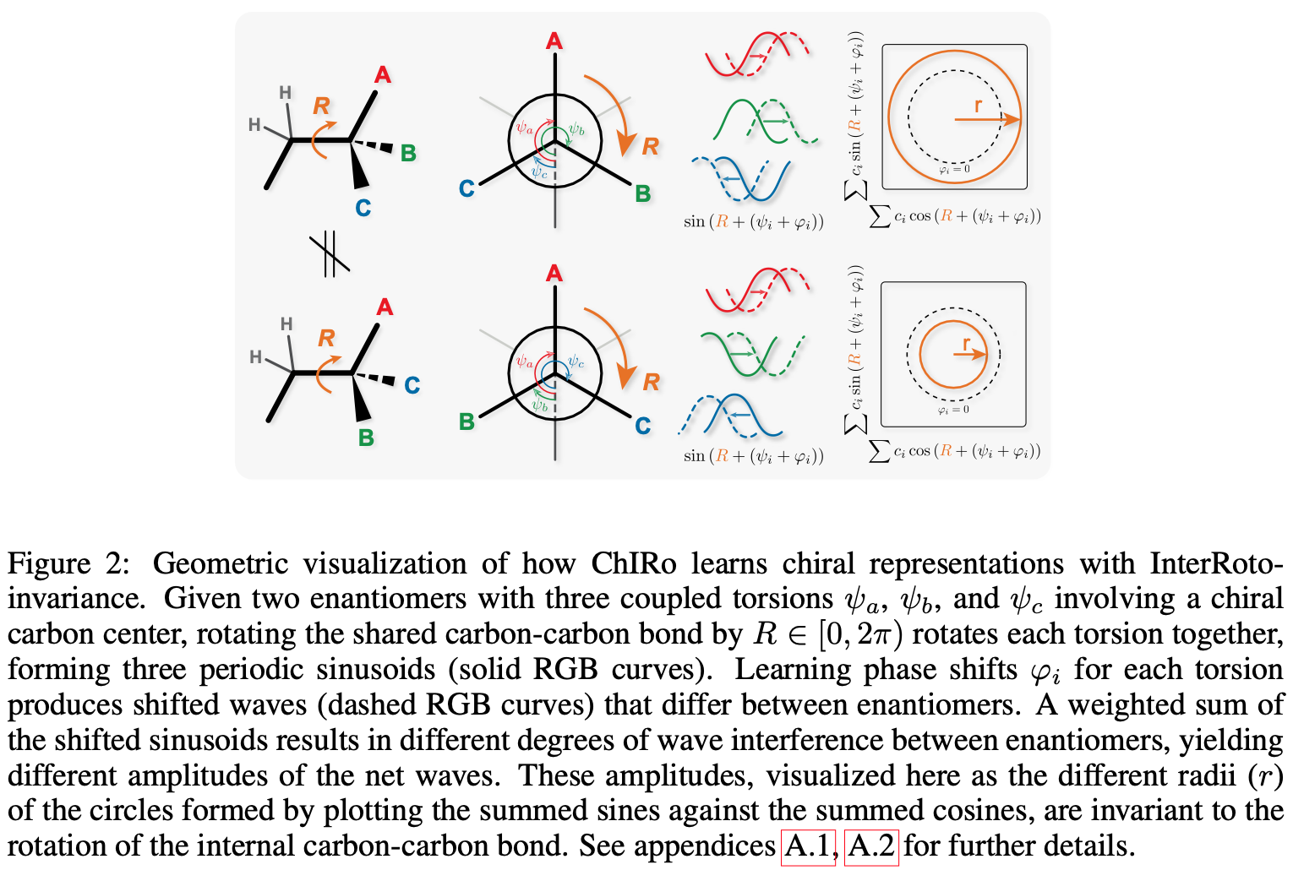
Chiral InterRoto-Invariant Neural Network (ChiRo)
Torsion Encoder

Slide 11
Chiral InterRoto-Invariant Neural Network (ChiRo)
Torsion Encoder - How ChiRo achieves invariance to Conformation changes
For every internal bond between nodes $x$ and $y$, there are a set of coupled torsions
$$\left(α_{cos}^{(xy)},α_{sin}^{(xy)}\right)=\underset{i∈N(x)\backslash \{y\}}{∑}\underset{j∈N(y)\backslash \{x\}}{∑}c_{ij}^{(xy)}⋅\left(cos\left(ψ_{ixyj}\right),sin\left(ψ_{ixyj}\right)\right)$$
$$c_{ij}^{(xy)}=σ\left(f_{c}\left(h_{i},h_{x},h_{y},h_{j}\right)+f_{c}\left(h_{j},h_{y},h_{x},h_{i}\right)\right)$$
Thereby we have $\left(α_{cos}^{(xy)},α_{sin}^{(xy)}\right)$ encoded the torsions and invariant to the changes in conformations.

Slide 12
Chiral InterRoto-Invariant Neural Network (ChiRo)
Torsion Encoder - Why $\left(α_{cos}^{(xy)},α_{sin}^{(xy)}\right)$ is invariant to conformation changes
$$\begin{matrix}α_{cos}^{(xy)} & =\underset{i∈N(x)\backslash \{y\}}{∑}\underset{j∈N(y)\backslash \{x\}}{∑}c_{ij}^{(xy)}cos\left(ψ_{ixyj}+φ_{ixyj}\right) \\ α_{sin}^{(xy)} & =\underset{i∈N(x)\backslash \{y\}}{∑}\underset{j∈N(y)\backslash \{x\}}{∑}c_{ij}^{(xy)}sin\left(ψ_{ixyj}+φ_{ixyj}\right)\end{matrix}$$
$${\left\{ψ_{ixyj}\right\}}_{(i,j)}={\left\{ψ_{k}\right\}}_{k=1}^{n}$$
$R∈[0,2π)$ is a rotation of the bond $(x,y)$,$\overset{n}{\underset{k=1}{∑}}c_{k}sin\left(R+ψ_{k}+φ_{k}\right)$ versus $\overset{n}{\underset{k=1}{∑}}c_{k}cos\left(R+ψ_{k}+φ_{k}\right)$ yield a circle with a constant radius invariant to R

Slide 13
Chiral InterRoto-Invariant Neural Network (ChiRo)
Torsion Encoder - Why $\left(α_{cos}^{(xy)},α_{sin}^{(xy)}\right)$ is invariant to conformation changes
As a simple case, consider n = 2
$$α_{cos}=c_{1}cos\left(R+ψ_{1}+φ_{1}\right)+c_{2}cos\left(R+ψ_{2}+φ_{2}\right)=c_{1}cos\left(R+θ_{1}\right)+c_{2}cos\left(R+θ_{2}\right)$$
$$\begin{matrix} & c_{1}cos\left(R+θ_{1}\right)+c_{2}cos\left(R+θ_{2}\right)= \\ & c_{1}\left(cos(R)cos\left(θ_{1}\right)-sin(R)sin\left(θ_{1}\right)\right)+c_{2}\left(cos(R)cos\left(θ_{2}\right)-sin(R)sin\left(θ_{2}\right)\right)= \\ & acos(R)-bsin(R)=dcos(R+e)\end{matrix}$$
$$\begin{matrix}a & =dcose=c_{1}cos\left(θ_{1}\right)+c_{2}cos\left(θ_{2}\right) \\ b & =dsine=c_{1}sin\left(θ_{1}\right)+c_{2}sin\left(θ_{2}\right)\end{matrix}$$

Slide 14
Chiral InterRoto-Invariant Neural Network (ChiRo)
Torsion Encoder - Why $\left(α_{cos}^{(xy)},α_{sin}^{(xy)}\right)$ is invariant to conformation changes
$$α_{sin}=c_{1}sin\left(R+ψ_{1}+φ_{1}\right)+c_{2}sin\left(R+ψ_{2}+φ_{2}\right)=c_{1}sin\left(R+θ_{1}\right)+c_{2}sin\left(R+θ_{2}\right)$$
$$\begin{matrix} & c_{1}sin\left(R+θ_{1}\right)+c_{2}sin\left(R+θ_{2}\right)= \\ & c_{1}\left(sin(R)cos\left(θ_{1}\right)+cos(R)sin\left(θ_{1}\right)\right)+c_{2}\left(sin(R)cos\left(θ_{2}\right)+cos(R)sin\left(θ_{2}\right)\right)= \\ & a^{′}sin(R)+b^{′}cos(R)=d^{′}sin\left(R+e^{′}\right)\end{matrix}$$
$$\begin{matrix}a^{′} & =d^{′}cose^{′}=c_{1}cos\left(θ_{1}\right)+c_{2}cos\left(θ_{2}\right) \\ b^{′} & =d^{′}sine^{′}=c_{1}sin\left(θ_{1}\right)+c_{2}sin\left(θ_{2}\right)\end{matrix}$$

Slide 15
Chiral InterRoto-Invariant Neural Network (ChiRo)
Torsion Encoder - Why $\left(α_{cos}^{(xy)},α_{sin}^{(xy)}\right)$ is invariant to conformation changes
Therefore we have $α_{cos}=dcos(R+e)$ and $α_{sin}=dsin(R+e)$
In general case $(n≥2)$
$$\begin{matrix}α_{cos} & =\overset{n}{\underset{k=1}{∑}}c_{k}cos\left(ωt+ψ_{k}+φ_{k}\right)=rcos(R+s) \\ α_{sin} & =\overset{n}{\underset{k=1}{∑}}c_{k}sin\left(ωt+ψ_{k}+φ_{k}\right)=rsin(R+s)\end{matrix}$$
Thus, $∥α_{cos}^{(xy)},α_{sin}^{(xy)}∥$is a value that depends solely on $c_{ij}^{(xy)}$, torsion $ψ_{ixyj}$, and phase shifts $φ_{ixyj}$ regardless of the variance of R.

Slide 16
Chiral InterRoto-Invariant Neural Network (ChiRo)
Torsion Encoder - How ChiRo achieves sensitivity to Chirality
The author adds a learned phase shift $φ_{ixyj}$ to each torsion $ψ_{ixyj}$.
$$\left(cosφ_{ixyj},sinφ_{ixyj}\right)=ℓ_{2}^{norm}\left(f_{φ}\left(h_{i},h_{x},h_{y},h_{j}\right)+f_{φ}\left(h_{j},h_{y},h_{x},h_{i}\right)\right)$$
$$\left(α_{cos}^{(xy)},α_{sin}^{(xy)}\right)=\underset{i∈N(x)\backslash \{y\}}{∑}\underset{j∈N(y)\backslash \{x\}}{∑}c_{ij}^{(xy)}⋅\left(cos\left(ψ_{ixyj}+φ_{ixyj}\right),sin\left(ψ_{ixyj}+φ_{ixyj}\right)\right)$$

Slide 17
Chiral InterRoto-Invariant Neural Network (ChiRo)
Torsion Encoder
$$z_{α}=\underset{(x,y)∈G}{∑}z_{α_{xy}}$$
$$z_{α_{xy}}=f_{α}\left(h_{x},h_{y},∥α_{cos}^{(xy)},α_{sin}^{(xy)}∥\right)+f_{α}\left(h_{y},h_{x},∥α_{cos}^{(xy)},α_{sin}^{(xy)}∥\right)$$

Slide 18
Chiral InterRoto-Invariant Neural Network (ChiRo)
Readout
Concatenate the sum-pooled note states with the conformer embedding components (bond distance, bond angle, and torsions)
$$\overset{̂}{y}=f_{\text{out}}\left(\underset{i∈G}{∑}h_{i},z_{d},z_{ϕ},z_{α}\right)$$

Slide 19
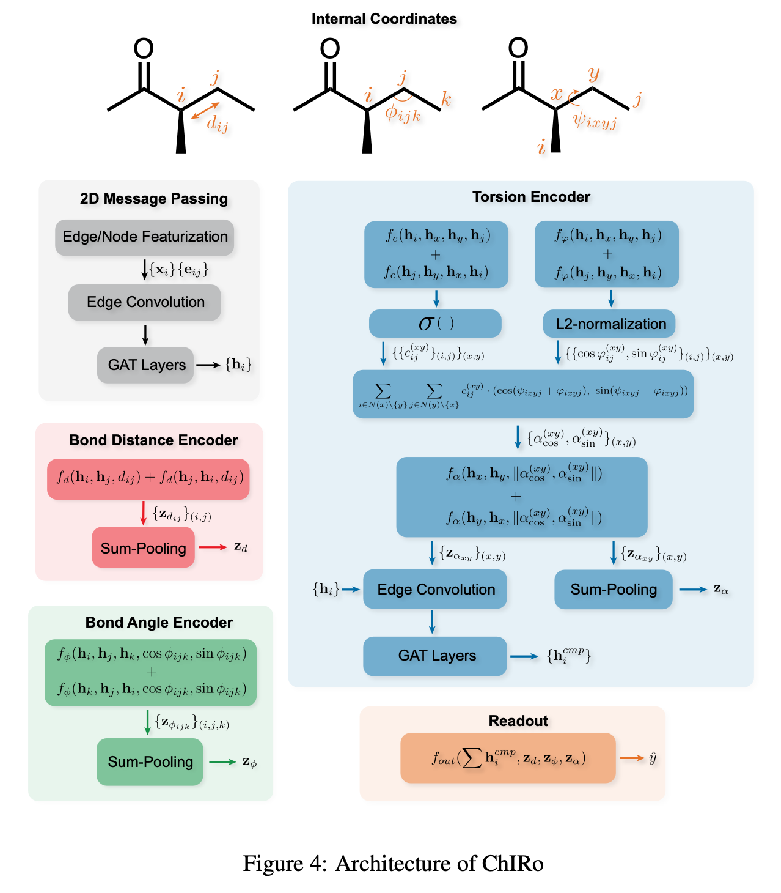
Chiral InterRoto-Invariant Neural Network (ChiRo)

Slide 20
Experiments
The author evaluates the ability of the model through four tasks:
Contrastive Learning to Distinguish Stereoisomers
Classifying Tetrahedral Chiral Centers as R/S
Predicting Enantiomers’ Signs of Optical Rotation
Ranking Enantiomers by Binding Affinity in a Chiral Protein Pocket

Slide 21
Experiments
Contrastive Learning to Distinguish Stereoisomers
Problem setting: For a subset of the PubChem3D dataset, which consists of multiple OMEGA-generated conformations, the author tries to answer the question of whether the model can learn to cluster conformers sharing the same (chiral) molecular identity in a learned latent space while distinguishing clusters belonging to different stereoisomers.
The loss function is defined as a triplet margin loss with a normalized Euclidean distance metric:
$$L_{\text{triplet}}=max\left(0,d\left(z_{a},z_{p}\right)-d\left(z_{a},z_{n}\right)+1\right),d\left(z_{1},z_{2}\right)=∥\frac{z_{1}}{∥z_{1}∥}-\frac{z_{2}}{∥z_{2}∥}∥$$

Slide 22
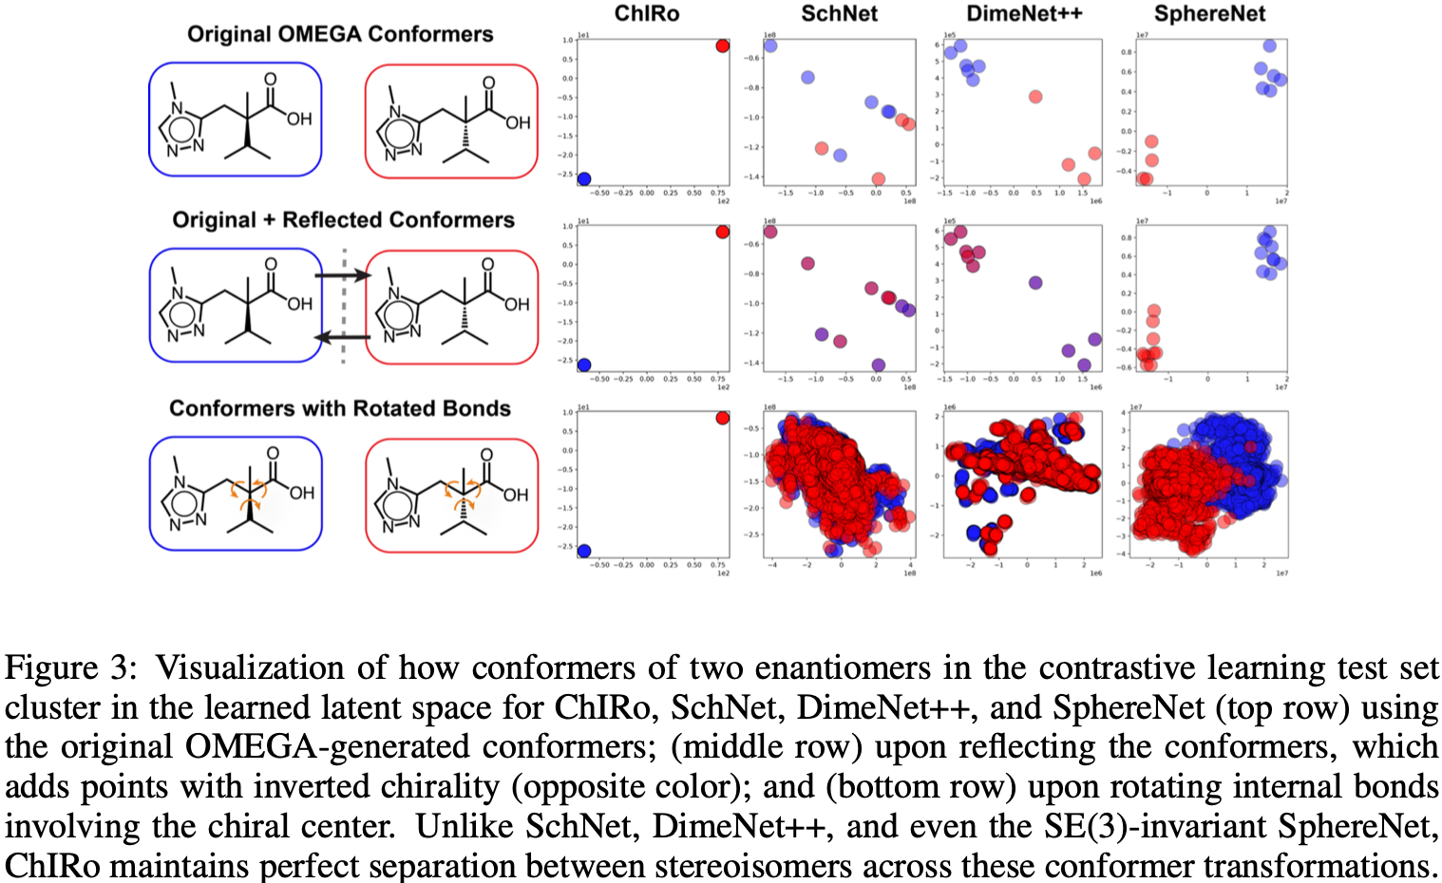
Experiments
Contrastive Learning to Distinguish Stereoisomers

Slide 23
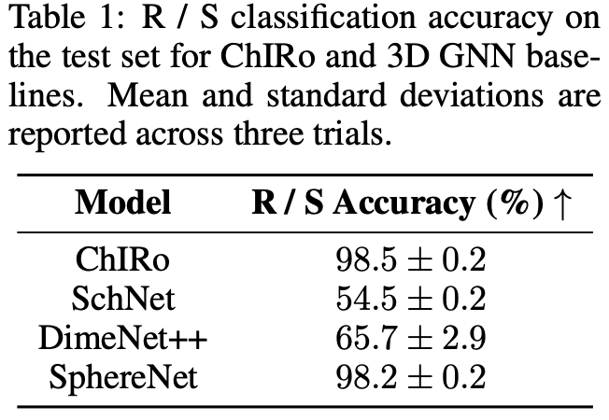
Experiments
Classifying Tetrahedral Chiral Centers as R/S
The experiment was conducted on a subset of PubChem3D containing enantiomers with one tetrahedral chiral centre.

Slide 24
Experiments
Ranking Enantiomers by Binding Affinity in a Chiral Protein Pocket
Select pairs of enantiomers whose difference in affinity scores is above a given threshold to form a dataset of enantiosensitve docking scores.
The evaluating metric is ranking accuracy.

Slide 25
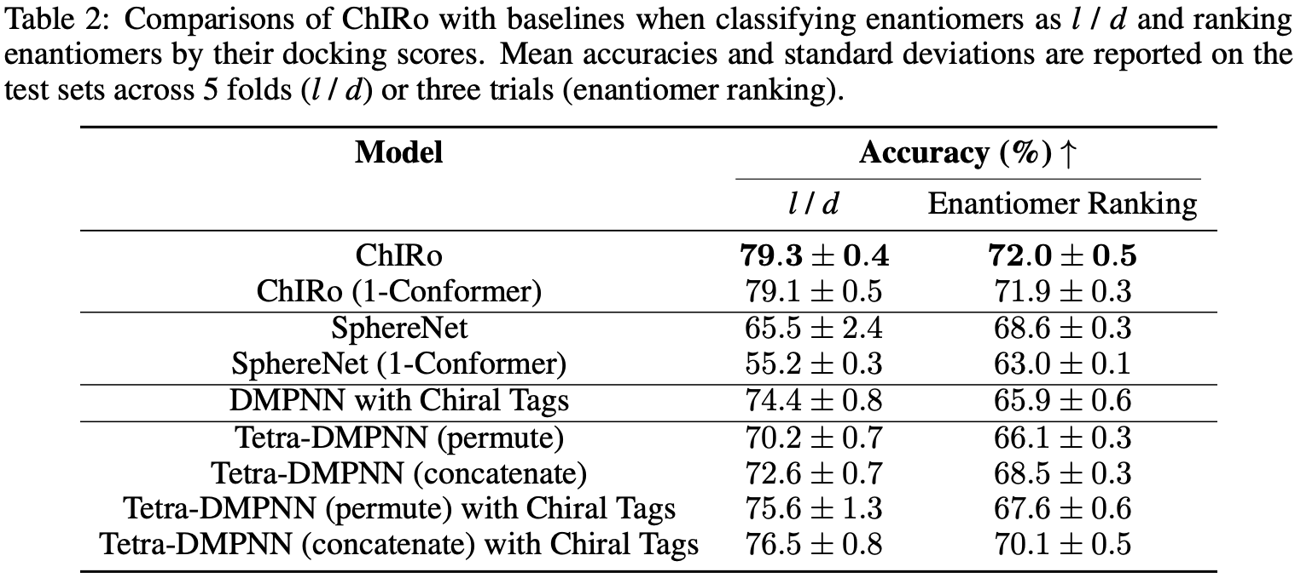
Experiments
Predicting Enantiomers’ Signs of Optical Rotation & Ranking Enantiomers by Binding Affinity in a Chiral Protein Pocket

Slide 26
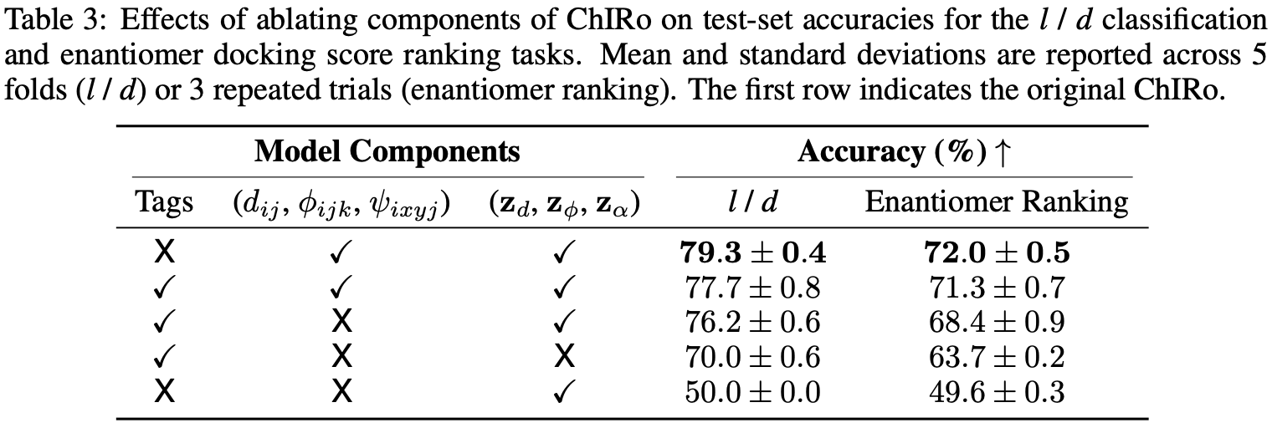
Experiments
Ablation Study

Slide 27
Conclusion & Discussion
The torsion encoder learns the representations of tetrahedral chirality by processing coupled torsion angles while achieving invariance to internal molecular bonds rotations and sensitivity to chirality simultaneously.
Other types of stereoisomerism, particularly cis/trans isomerism and atropisomerism, are left to future work.

